Slide 1
Changes to Captions: An Attentive Network for Remote Sensing Change Captioning
张锐捷
Shizhen Chang, Member, IEEE, and Pedram Ghamisi, Senior Member, IEEE

Slide 2
摘要解释
The network comprises three main components:
1) a Siamese CNN-based feature extractor to collect high-level representations for each image pair;
2) an attentive decoder that includes a hierarchical self-attention block to locate change-related features and a residual block to generate the image embedding;
3) a transformer-based caption generator to decode the relationship between the image embedding and the word embedding into a description.
该网络由三个主要部分组成:
1)基于Siamese cnn的特征提取器，用于收集每个图像对的高级表示;
2)注意解码器，包括用于定位变化相关特征的分层自注意块和用于生成图像嵌入的残差块;
3)基于变换的字幕生成器，将图像嵌入与单词嵌入之间的关系解码为描述。

Slide 3
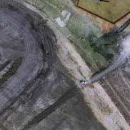
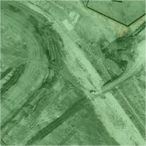
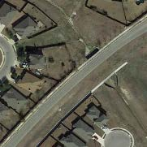
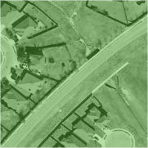
绘制过程
“ some roads and houses are built
<END>”
Hierarchical
Self-attention
CNN
Cosine Mask
1×1 Conv
BatchNorm
3×3 Conv
BatchNorm
1×1 Conv
BatchNorm
Linear & Softmax
K, V
Transformer
Decoder
Image 1
F₁
Positional
Embedding
×N
Q
Positional
Embedding
CNN
×N
ResBlock
Word Embedding
Image 2
F₂
“<START> some roads and houses
are built <END>”
(a) Feature Extractor
(b) Attentive Encoder
(c) Caption Decoder

Slide 4
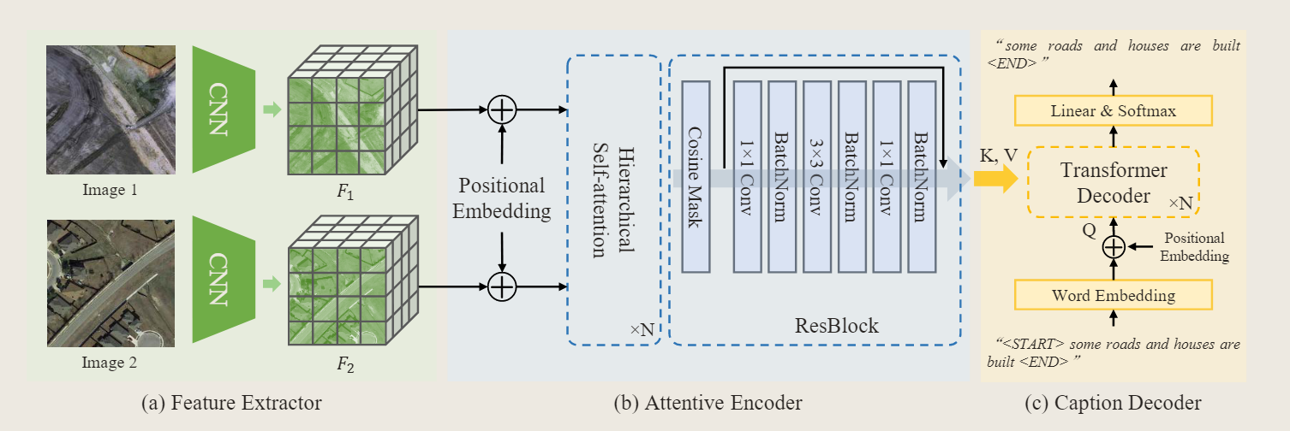
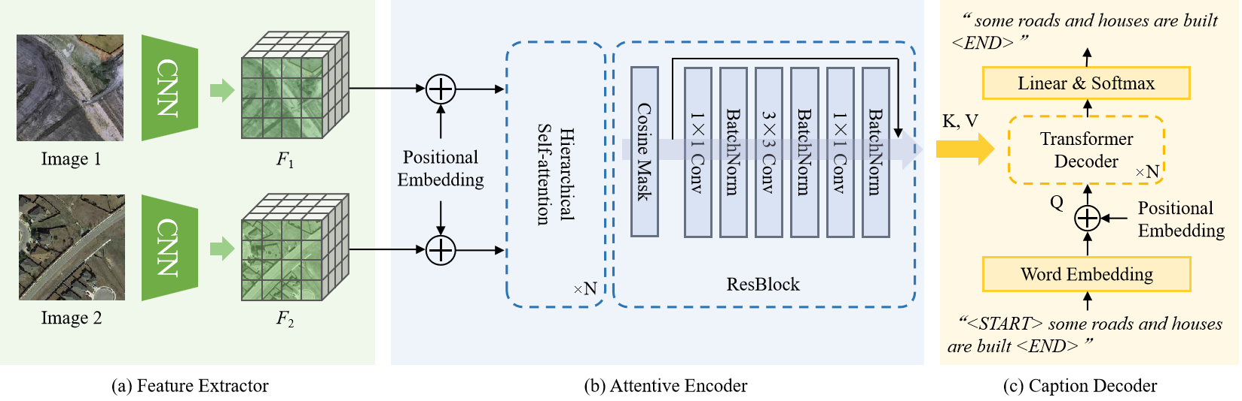
与原图对比

